Slide 1
Server-sent events with HTTP/2
By Jago Staes

Slide 2
Chuck norris jokes
Notes:
Use case

Slide 3

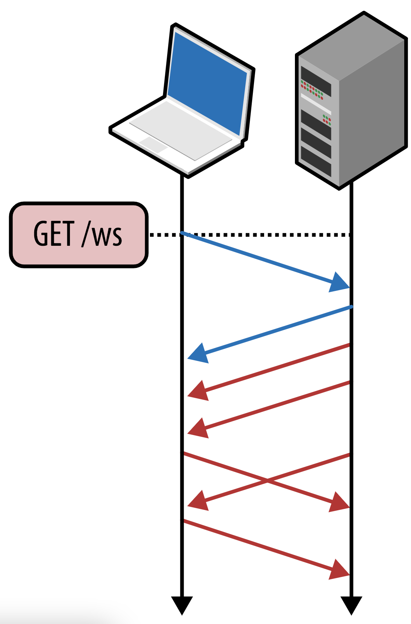
Websockets
Notes:
WHAT?
Websockets are a way to create an open communication between server and client, the client can send messages to the server and the server can send back event-driven responses without the need for the client to poll
WHY?
When a client wants to receive updates from the server without having to poll but also wants to communicate with the server websockets is the right choice
+ Older browser support
+ Bi-directional communication
+ Limitations server-sent events
More configuration
Stateful connection -> detect dropped connections
Keep the connection alive
Complex protocol

Slide 4
Websocket demo

Slide 5
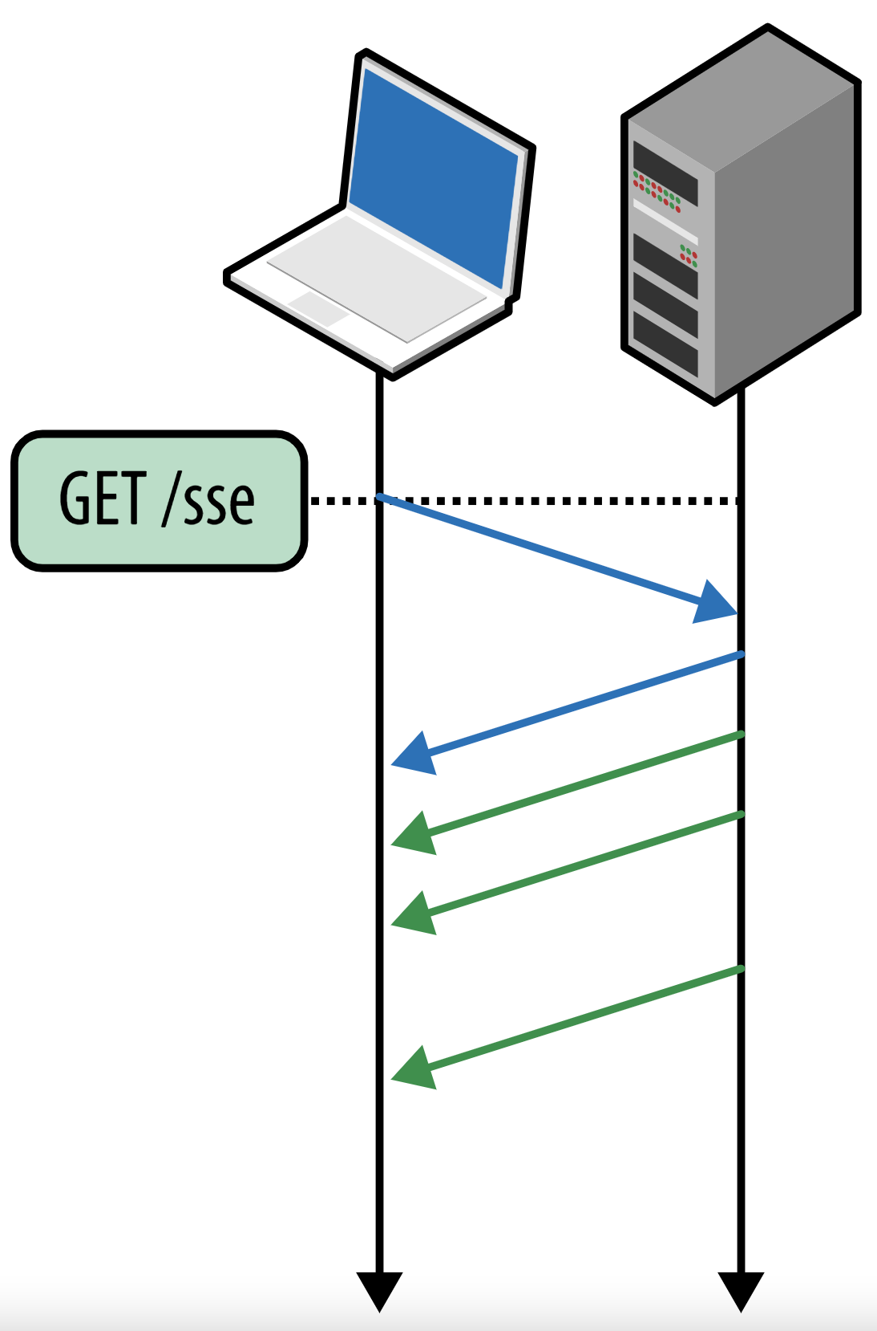
Server-sent events
Server-sent events is a technology where the client receives data (events) pushed by a server over HTTP
Notes:
Data over HTTP without polling
Use-cases
Stateless -> cloud-native applications
Built-in reconnect

Slide 6
SSE demo

Slide 7
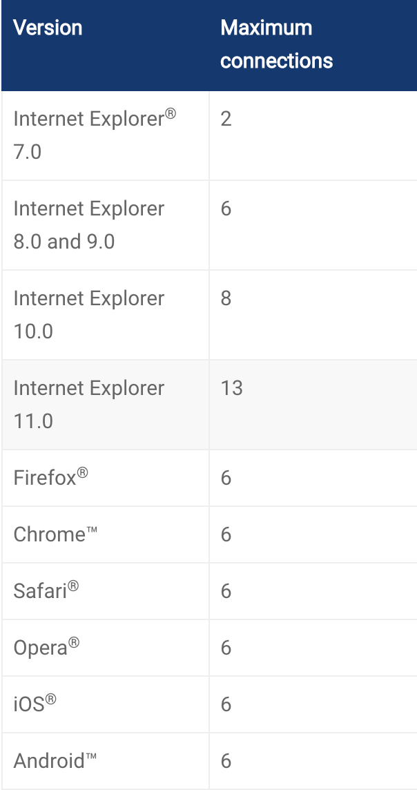
HTTP/1.1 drawbacks
Notes:
Text protocol -> errors & security issues
Parallel requests over multiple tcp connections -> more resource intensive
Limited amount of open connections

Slide 8
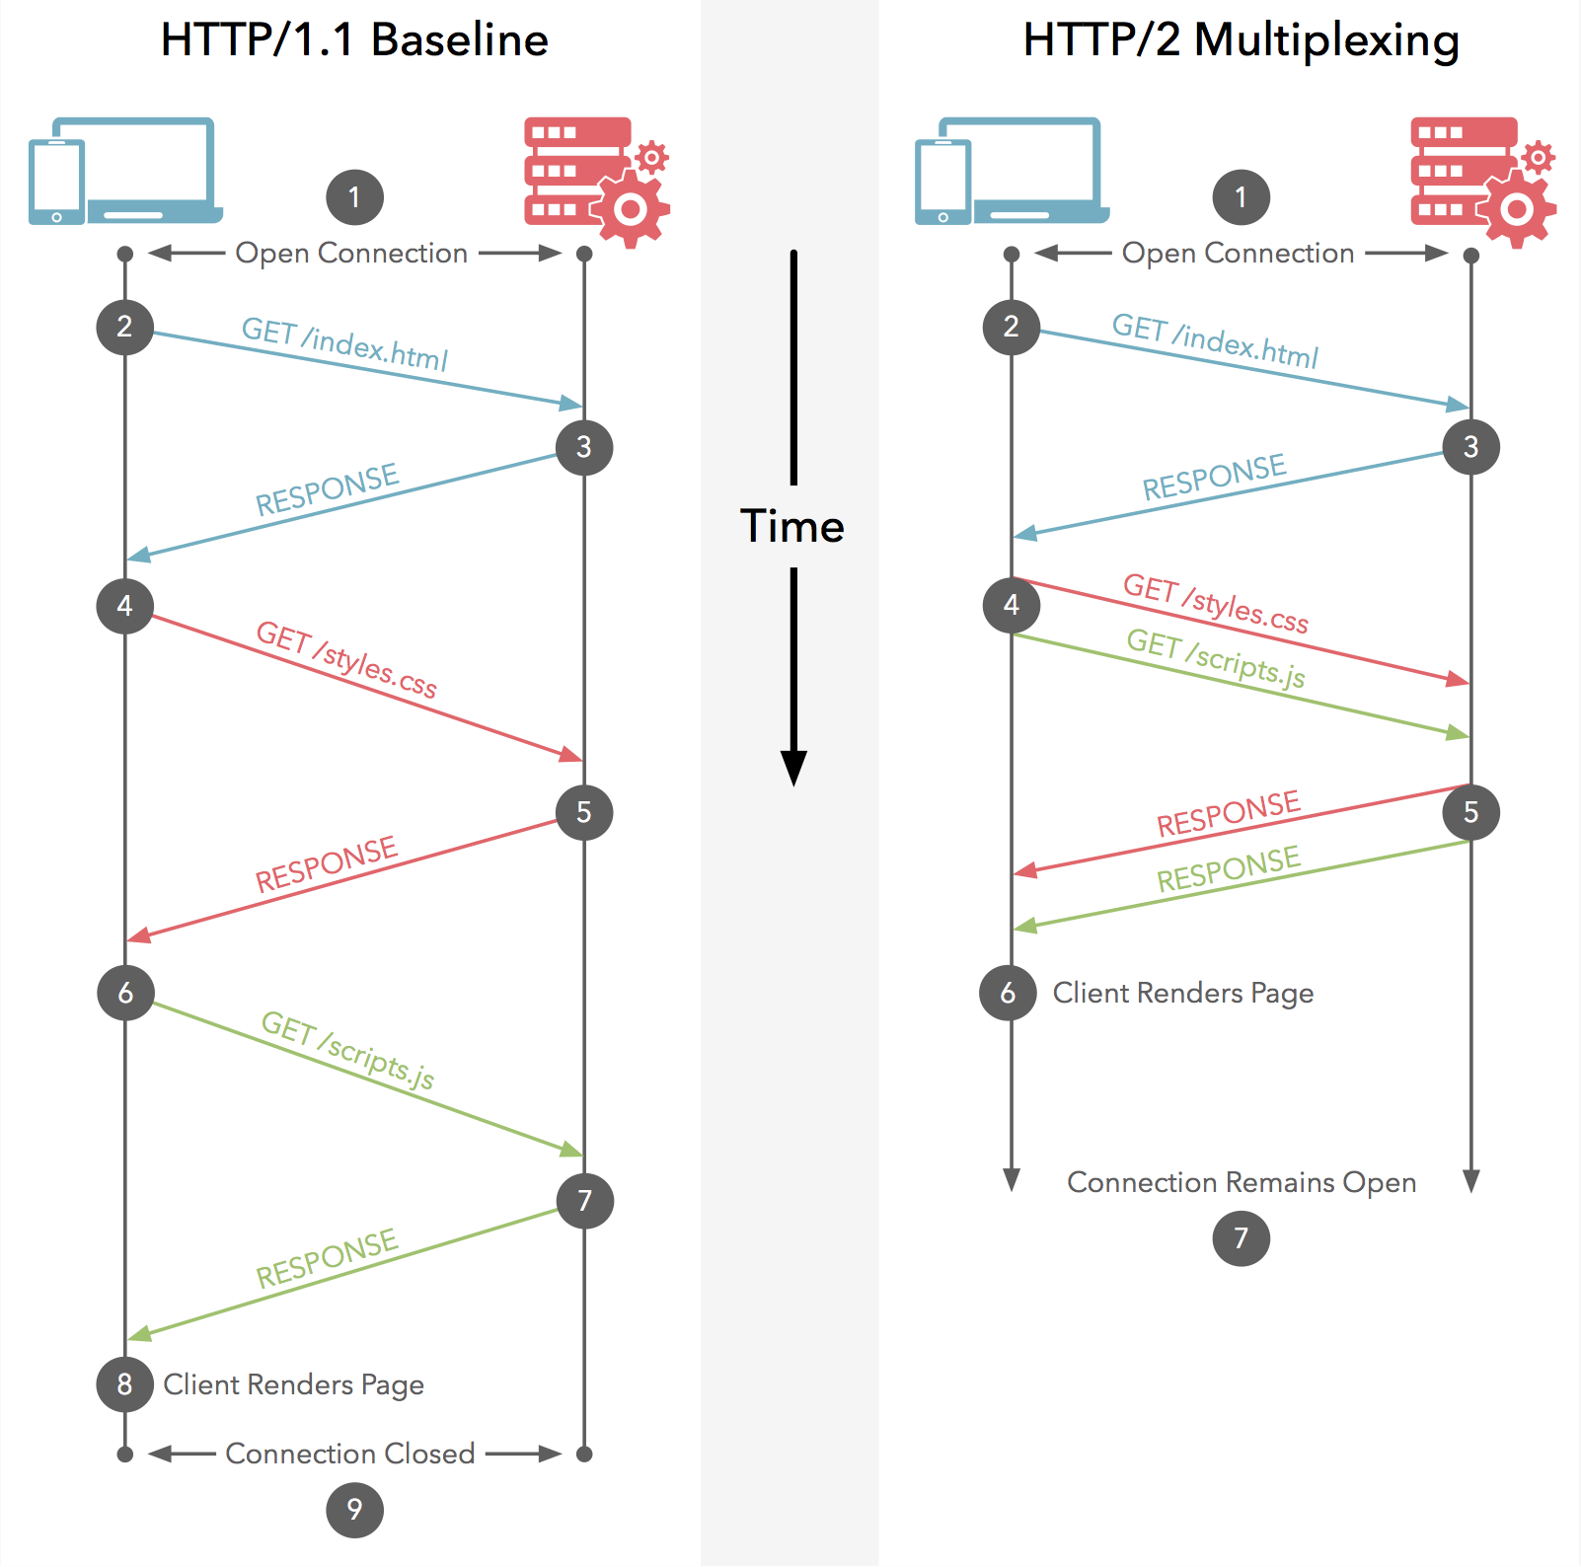
HTTP/1.1 vs HTTP/2
Notes:
http2
- Binary protocol -> less overhead parsing data
Parallel requests over single TCP connection
Reduced latency and improved network throughput
Backwards compatible
Over HTTPS
HTTP/2 Server push
HTTPS

Slide 9
TL;DR
Always use HTTP/2 to get the most out of SSE applications
The most important factor for making the descision between SSE and WebSocket is the use-case
Notes:
SSE with HTTP/1.1 is very limited

Slide 10
Any questions?

